Slide 1
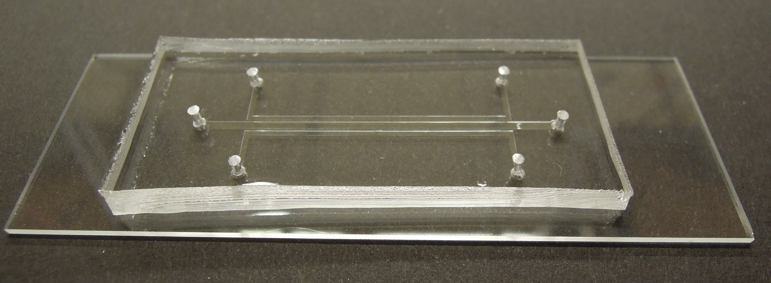

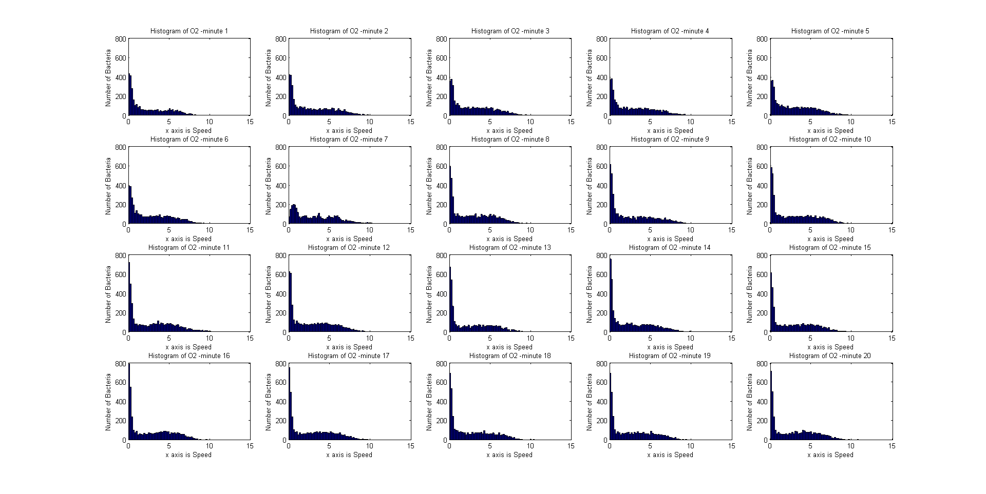
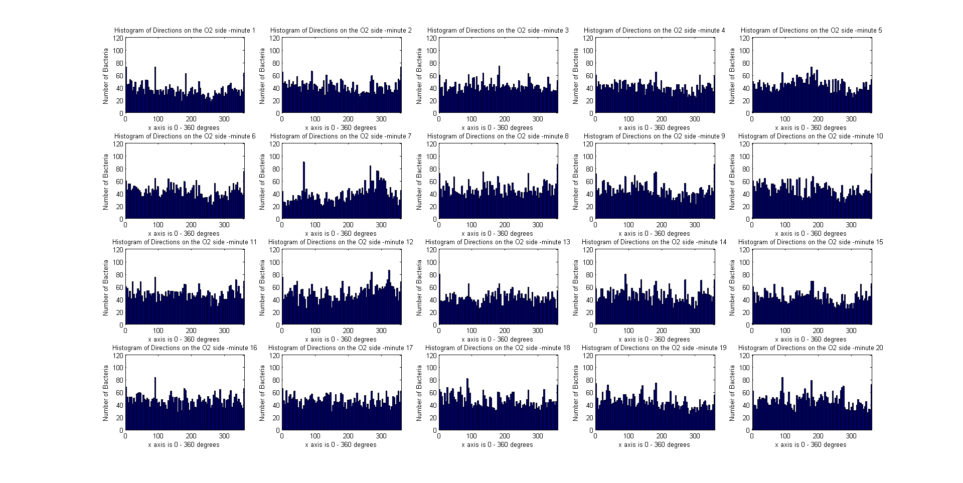
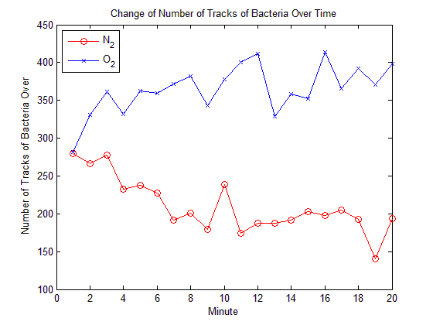
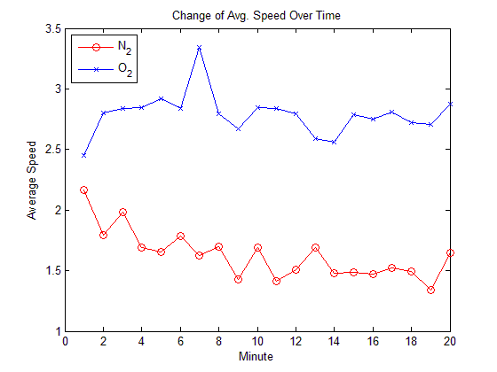
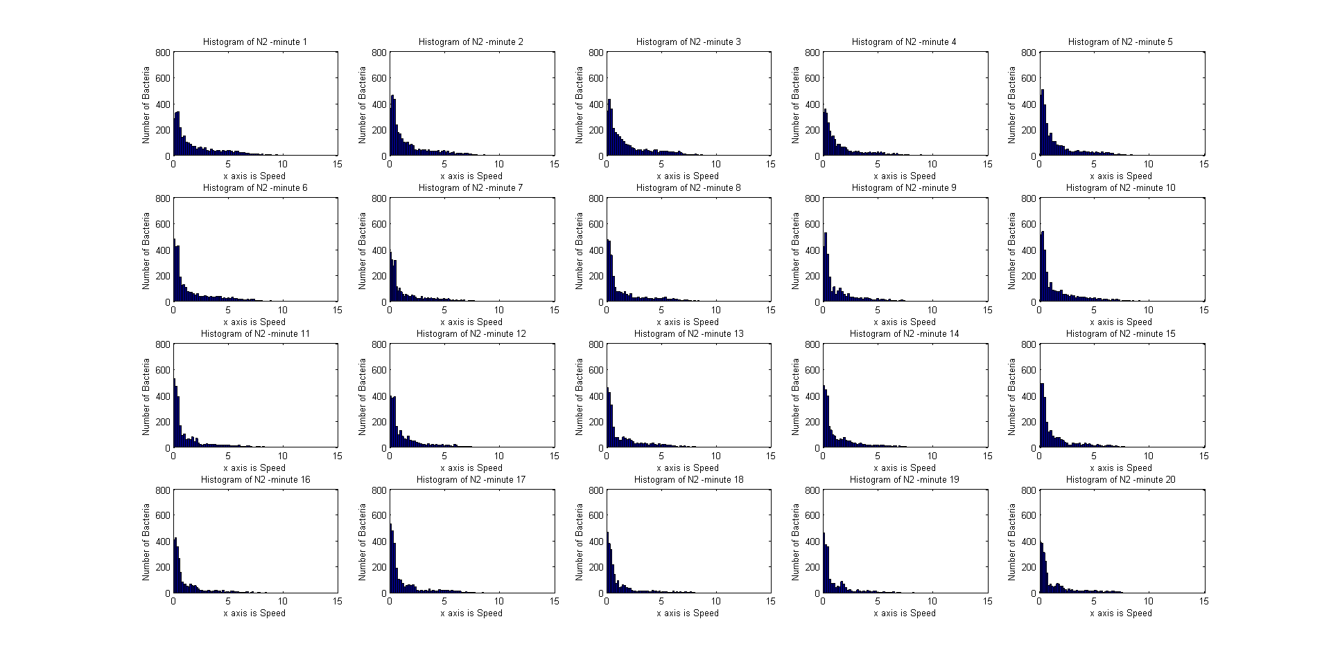

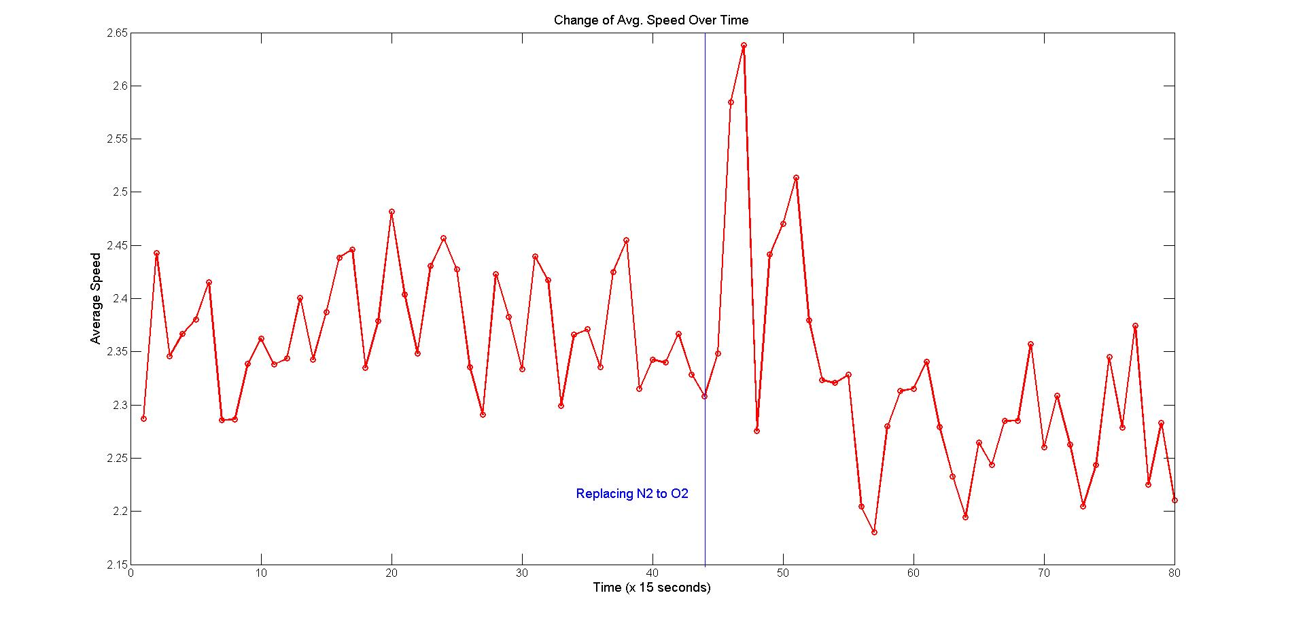
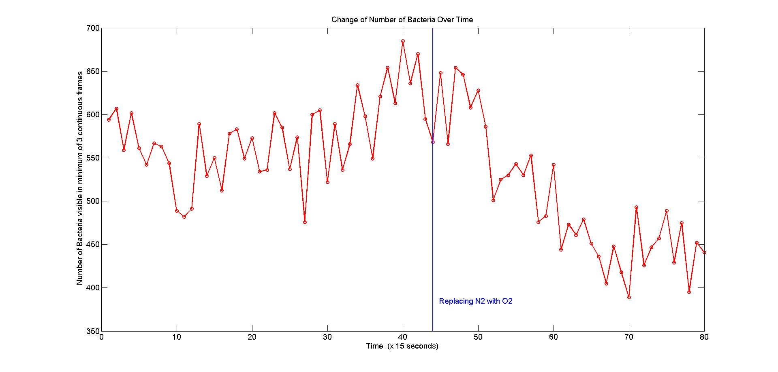
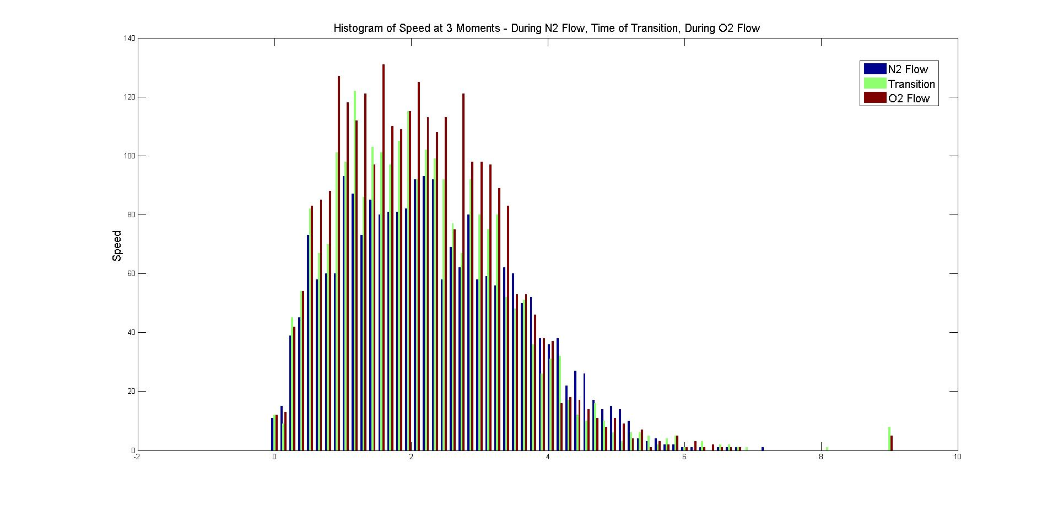
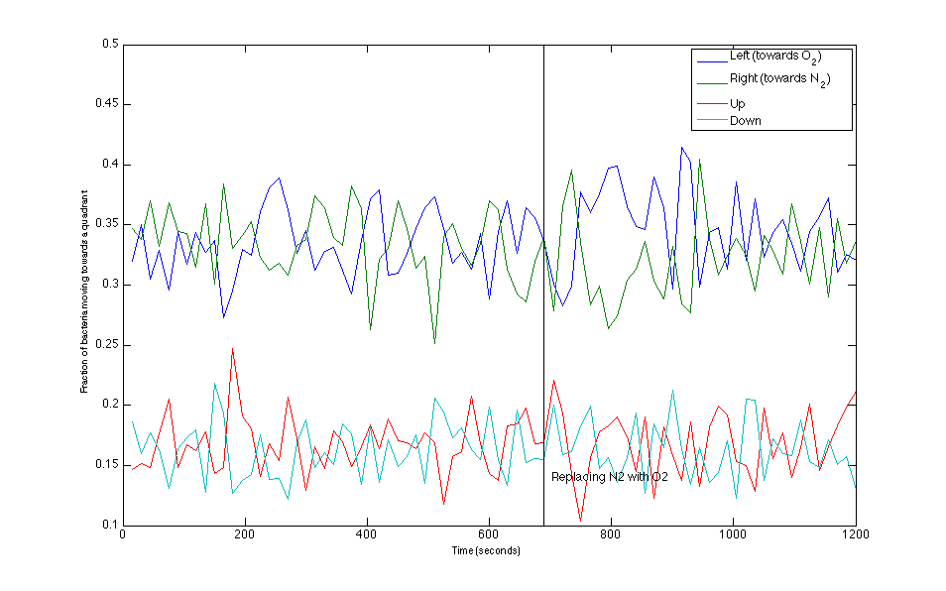
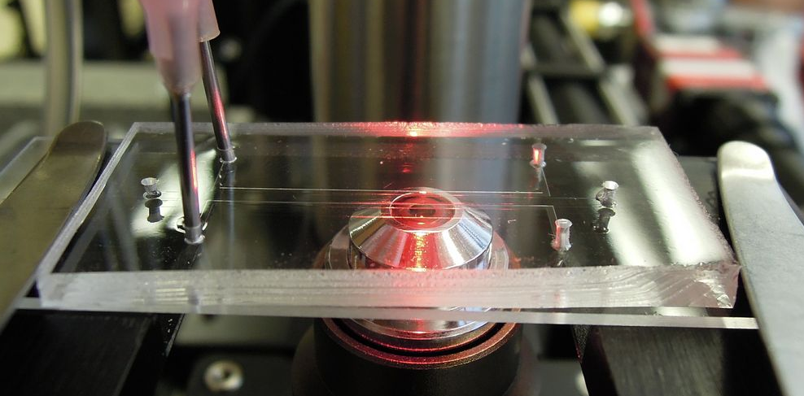
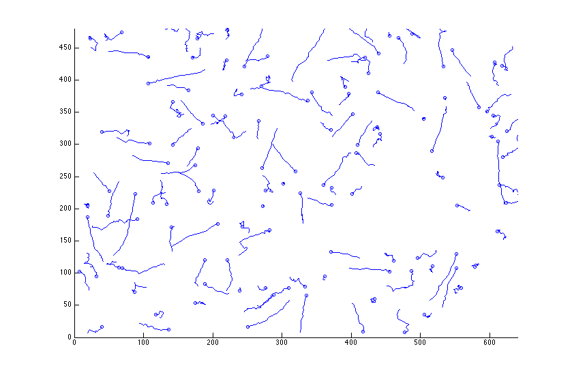
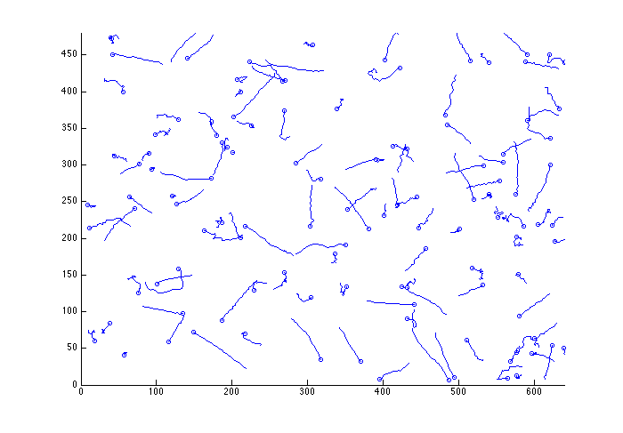
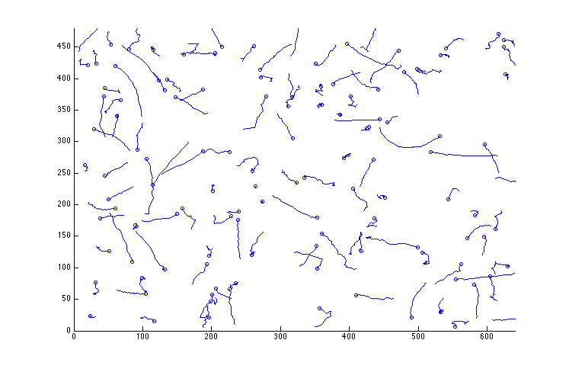
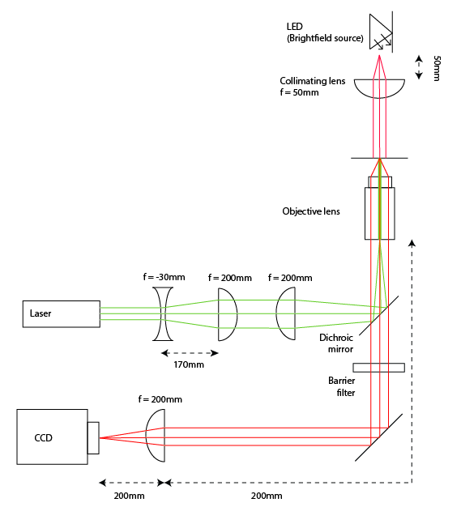
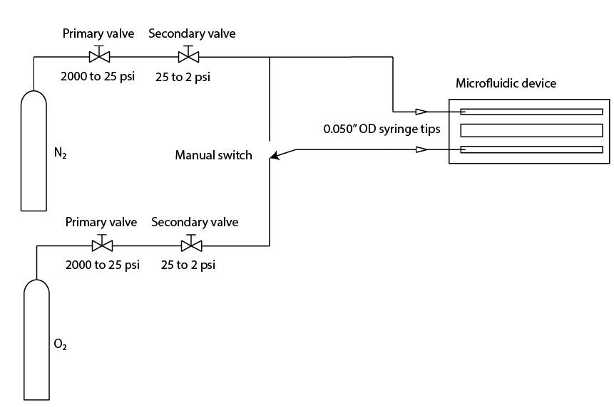
Aerotactic Behavior in B. subtilis
Kiarash Adl, Brian Djaja, Katarina Struckmann, Logan Williams, Filippo Menolascina, Steven Nagle
20.345 Bioinstrumentation Project Lab
Abstract
Results
Bacterial movement is influenced by environmental gradients on all levels of scale. While significant effort has been made to understand responses to chemical gradients, or chemotactic responses, less literature exists characterizing responses to gas gradients, or aerotactic responses. We have developed an apparatus for characterizing aerotactic bacterial motion, based on three microfluidic channels, fabricated from PDMS. We have shown as a proof of concept that the response of B. subtilis to a gradient of nitrogen and oxygen can be observed, through changes in population density. Quantitative analysis of bacterial motion was attempted, but inconclusive due to a high degree of random-walk behavior.
Experiment 1
30 frames in 1 second has been taken each minute on each side of the channel.
Aerotaxis
The movement of bacteria in response to a gas gradient, aerotaxis, is a field that has emerged within the past 10 years¹; as such, it has not been studied to the extent of chemotaxis, the movement of bacteria in response to a chemical gradient. While models of chemotactic movement exist^{2,3}, definitive models for aerotaxis have not yet been developed.
Aerotaxis has a broad range of applications. For example, the signaling proteins utilized in for aerotactic responses in bacteria can be potentially engineered for turning on gene expression in the presence of a certain oxygen concentration, or lack thereof. A definitive model for aerotactic behavior is the key to unlocking these applications.
Experiment 2
30 frames in 1 second has been taken every 15 seconds in the middle of channel
Experiment
The microfluidic device is composed of the elastomeric material Polydimethylsiloxane (PDMS). The device has three parallel channels formed by indentations in the PDMS.
Bacillus subtilis was obtained from Filippo Menolascina and cultured in Cap Assay Min (CAM), a minimal nutrient broth designed to increase the aerotactic response of the bacteria by placing them in mild starvation conditions. CAM contains trace amounts of tryptone, histidine, methionine, tryptophan, several mineral salts, and a phosphate buffer (pH = 7). The bacteria was cultured with
shaking for approximately 24
hours prior to experimentation.
Prior to oxygen flow
+1 minute
+3 minutes
Each channel is 600 microns wide and 50 microns deep, with 200 microns of separation between each channel. Bacteria was injected into the center channel and allowed to settle before data collection began. Oxygen and nitrogen flows were directed down the outside channels.
Conclusions
Text
The microscope used for the project was a standard 4f brightfield microscope based around inverted 200mm Nikon objectives.
N₂ and O₂ gases each flow through two regulators, dropping their pressure to 2 psi before they enter the device through 0.050” OD syringe tips.
Both channels were flushed with N₂ for 11.5 minutes before one channel was switched to a flow of O₂.
Acknowledgments
References
Text
FORMATTING REQUIRED
http://www.annualreviews.org/doi/pdf/10.1146/annurev.micro.53.1.103
http://www.ncbi.nlm.nih.gov/pubmed/18642048
http://www.ncbi.nlm.nih.gov/pubmed/18642047
MAY 2013

